Slide 1

Math 225 Final Project
Brendan Doyle, Sabrina Ma, Roger Wang

Slide 2
+
“Hosts manage to pay their inflated rents on time thanks to income generated by subletting part of their space through Airbnb.”
_
“Airbnb is driving rental prices up and changing the demographic characteristics of neighborhoods that are linked to gentrification.

Slide 3
Research Questions
Listing/Host Characteristics
Rent Prices
User Review Frequency
What types of places are being rented?
How many listings do hosts generally have?
Is there a correlation between price, minimum nights, number of reviews, and calculated host listing?
How does median listing price vary by neighborhood?
How has the number of reviews for listing in up-and-coming neighborhoods changed over time?

Slide 4
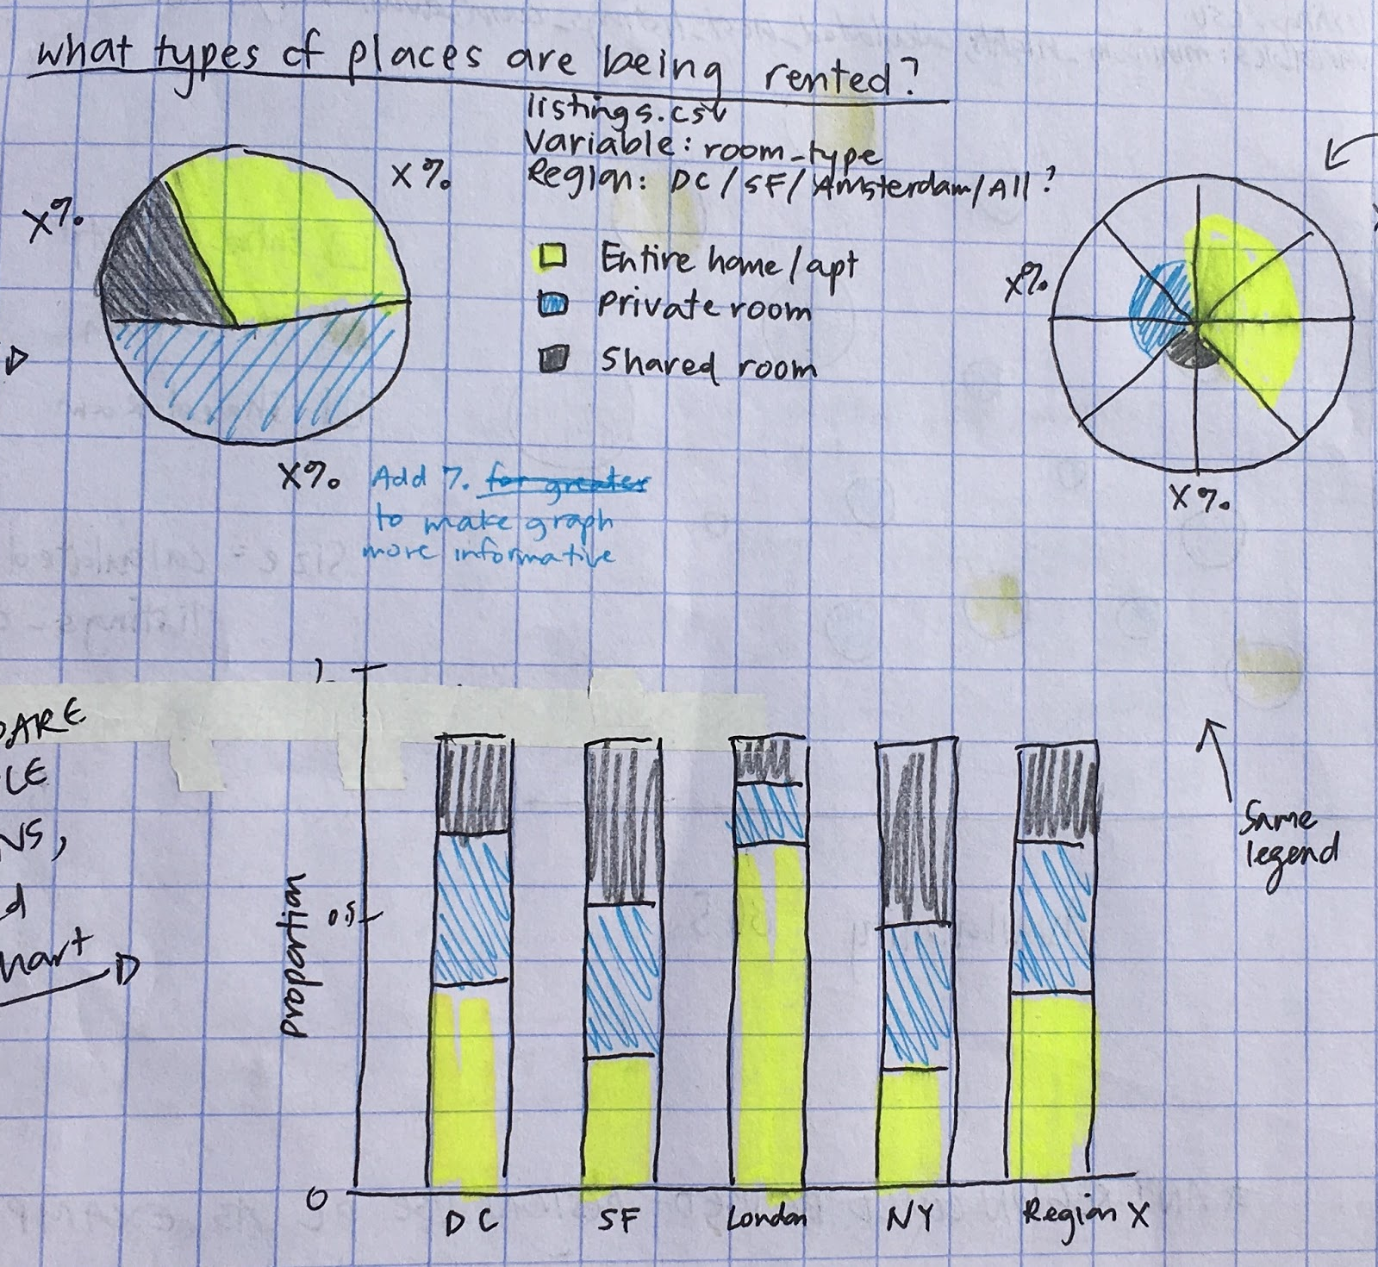
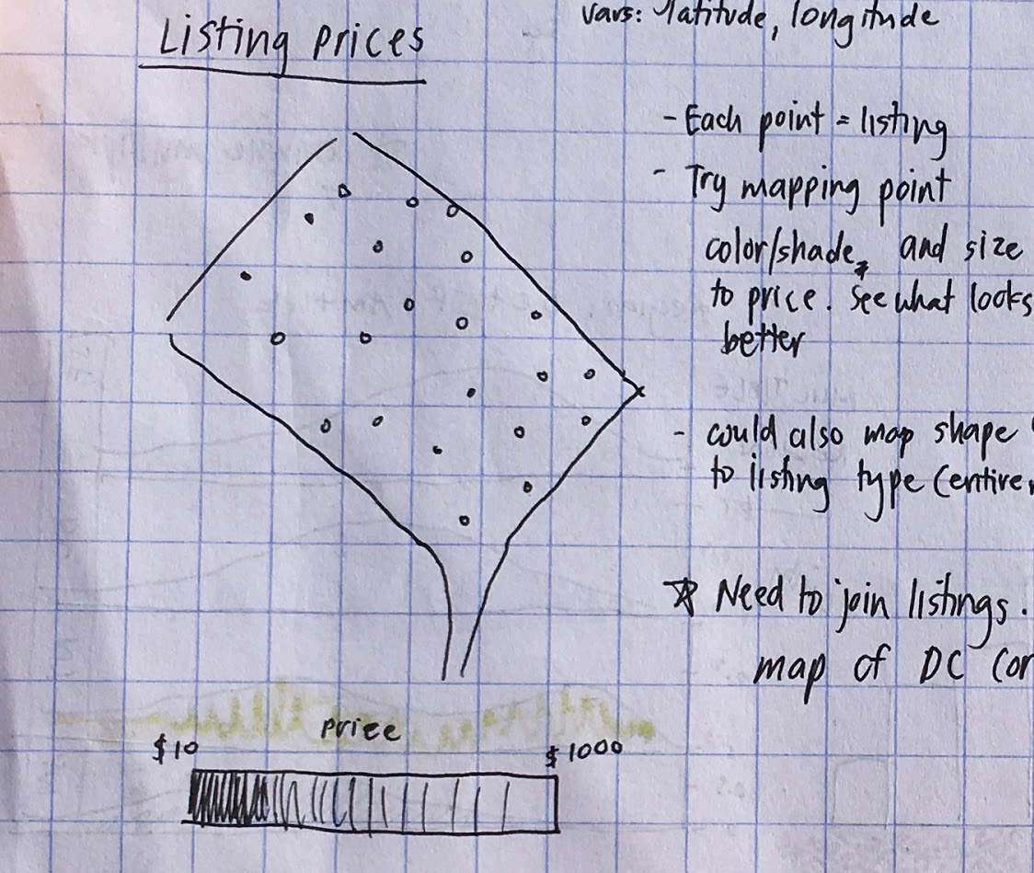
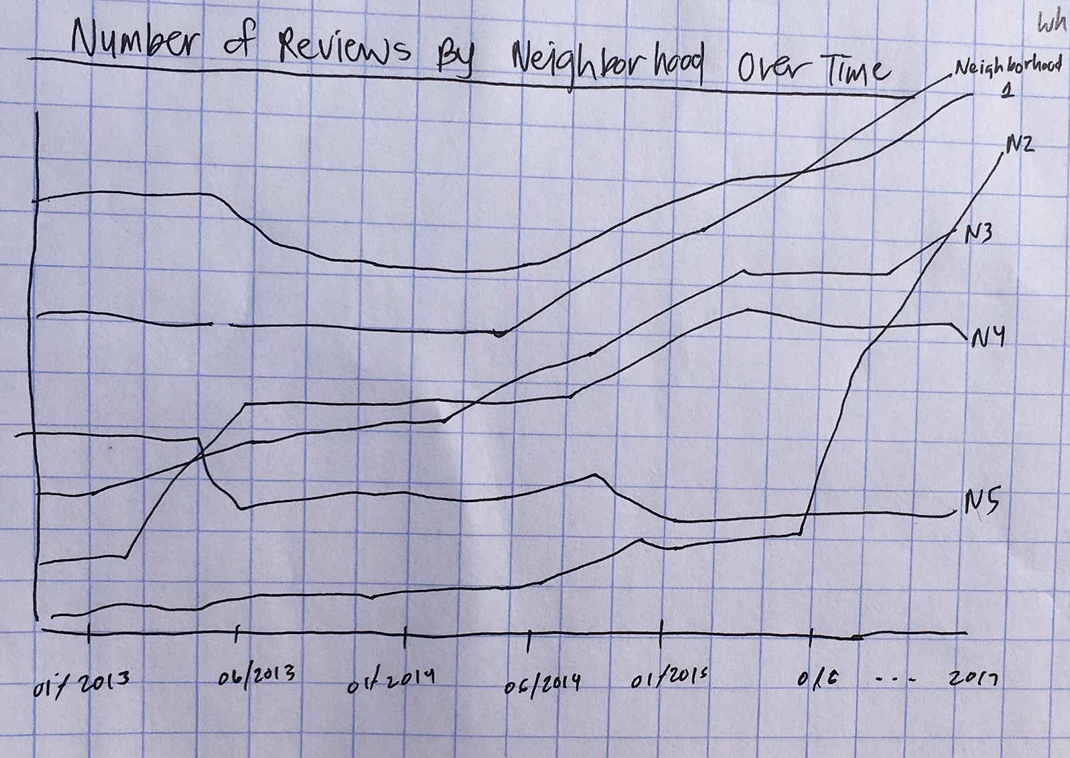
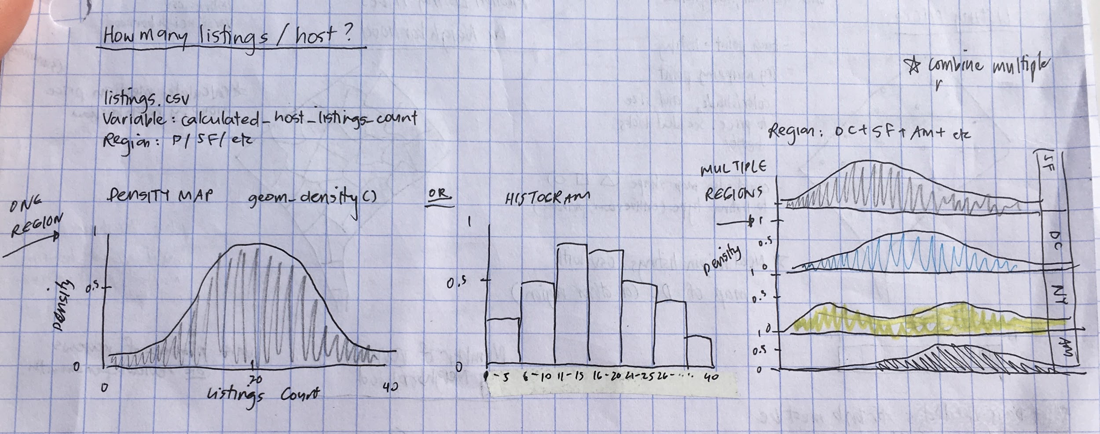
Design
Listing/Host Characteristics
Rent Prices
User Review Frequency

Slide 5
Data Description and Manipulation
InsideAirBnb (http://insideairbnb.com/about.html#disclaimers)
Listings.csv, Neighborhoods.csv, Reviews.csv
GeoJSON Data
The data utilizes public information compiled from the Airbnb web-site including the availability calendar for 365 days in the future, and the reviews for each listing. Data is verified, cleansed, analyzed and aggregated.
No "private" information is being used. Names, photographs, listings and review details are all publicly displayed on the Airbnb site.

Slide 6
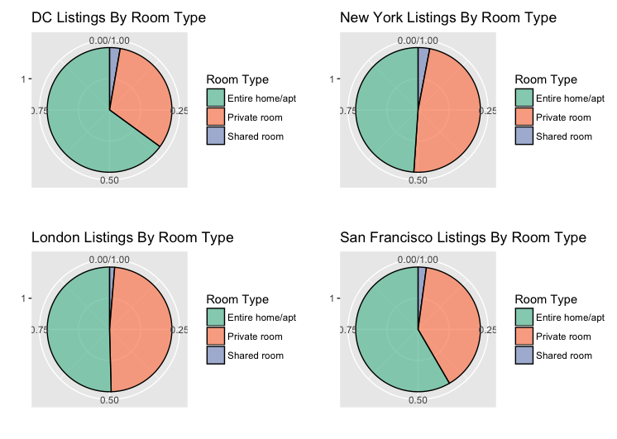
Q1: What types of places are being rented?

Slide 7
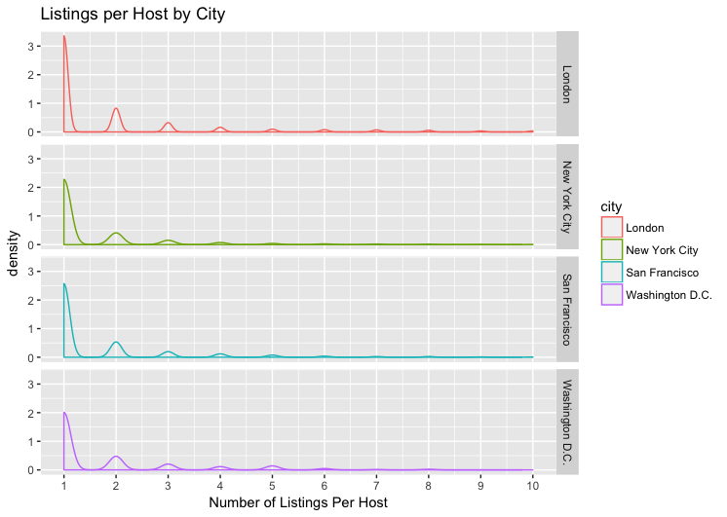
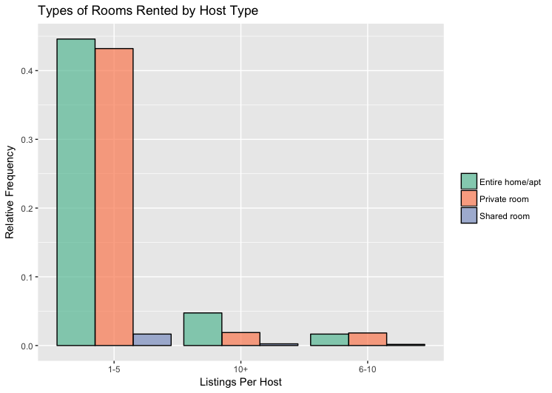
Q1: How many listings do hosts generally have?

Slide 8
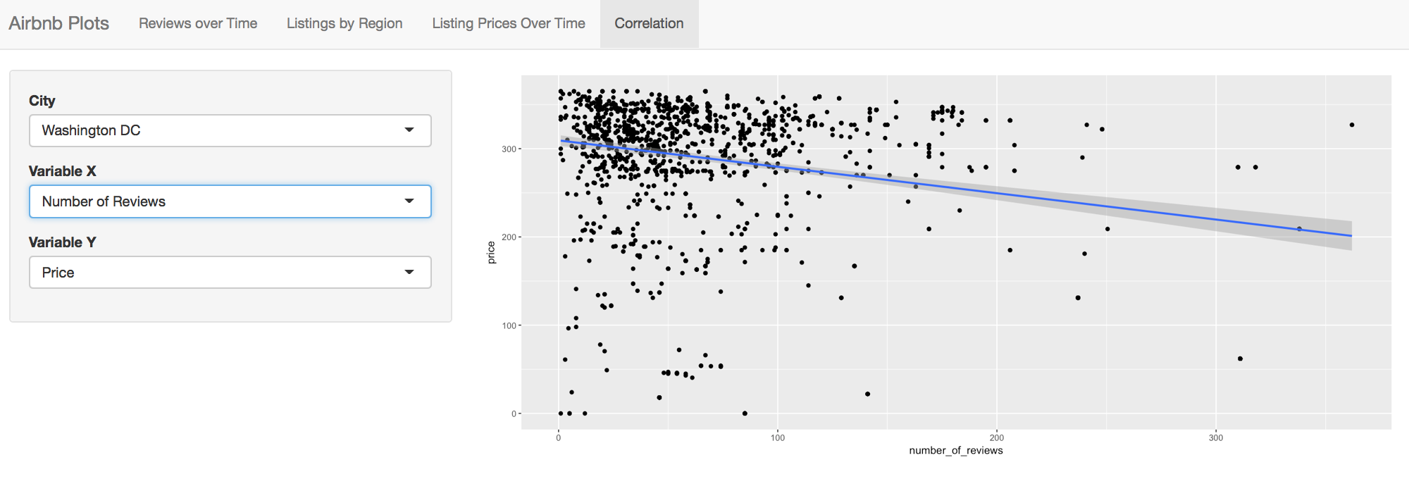
Q1: Is there a correlation between price, minimum nights, number of reviews, and calculated host listing?

Slide 9
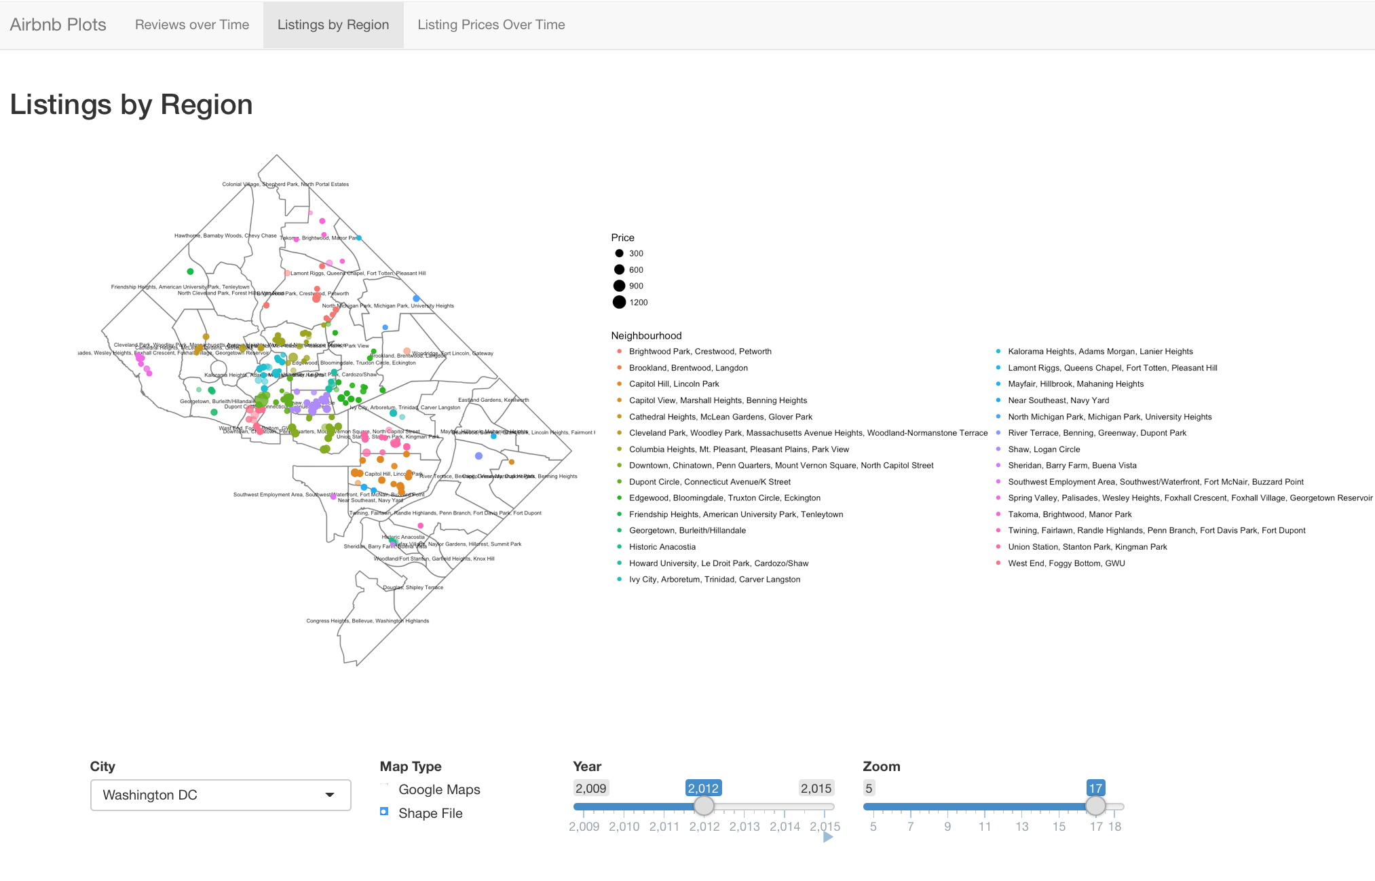
Q2: How does median listing price vary by neighborhood?

Slide 10
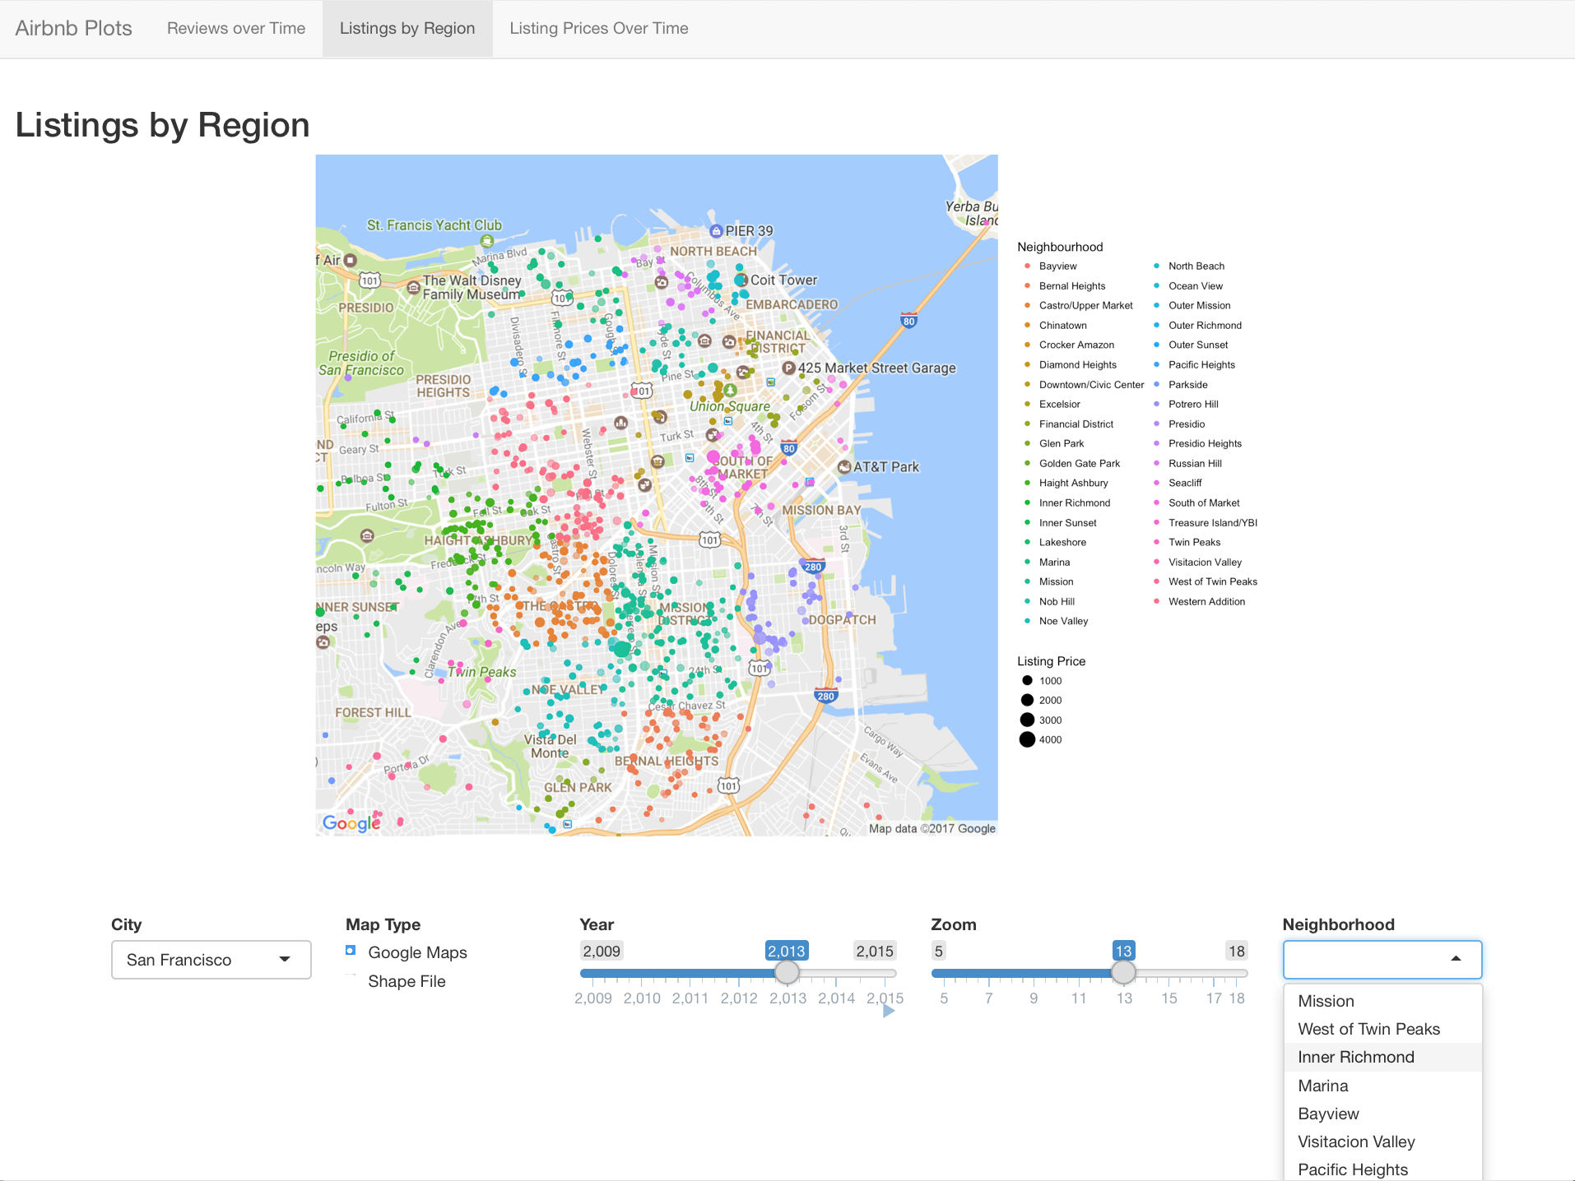
Q2: How does median listing price vary by neighborhood?

Slide 11
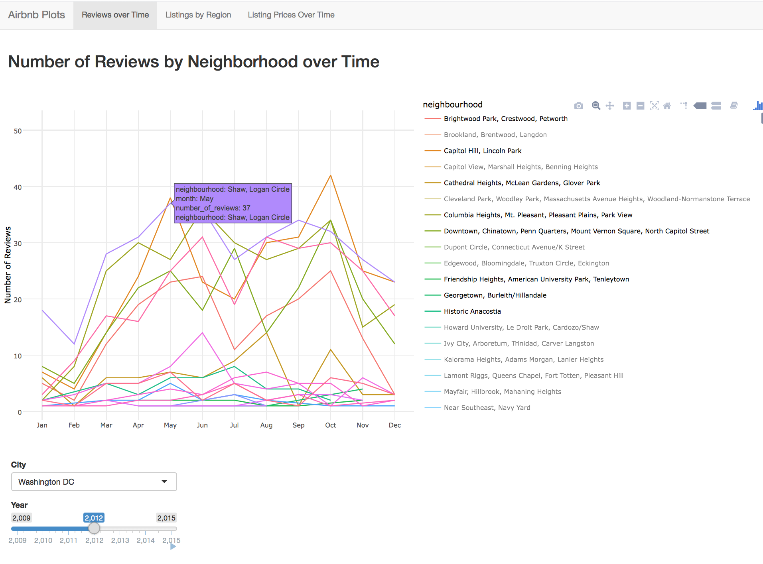
Q3: How has the number of reviews for listing in neighborhoods changed over time?

Slide 12
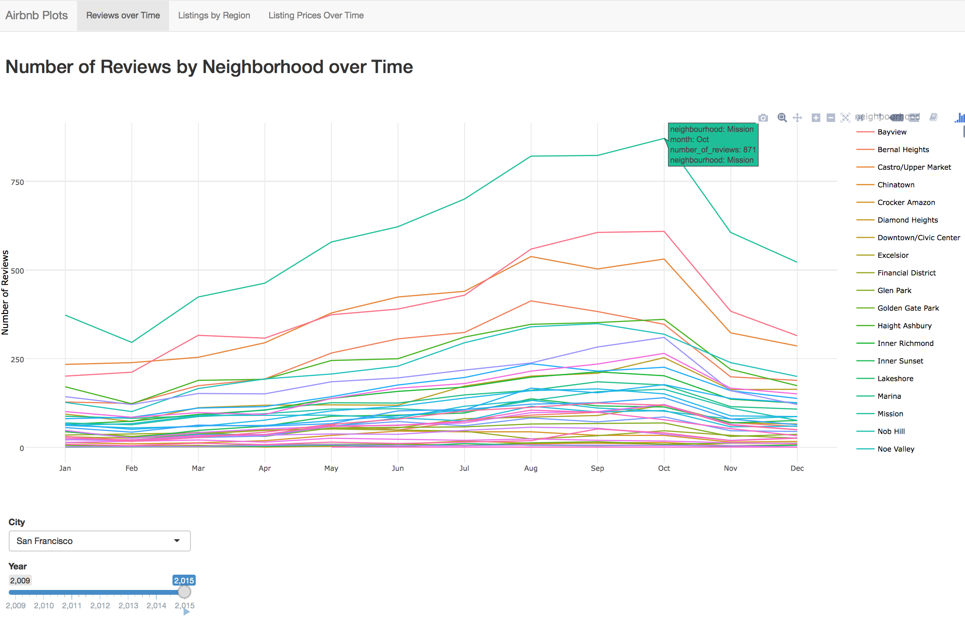
Q3: How has the number of reviews for listing in neighborhoods changed over time?

Slide 13
Strengths & Weaknesses
User interaction and customization
Google Maps
Region and neighborhood selection
Year animation
Zoom
Hover/mouseover information
Feature Limitations
Map points are not clickable
Ggplotly custom hover labels are not customizable
Data processing sometimes causes latency

Slide 14
Conclusion & Analysis
Some indications of a housing crisis in D.C.
Greater proportion of entire properties being rented
Slightly more listings per host compared to other cities
Hosts with 10+ listings are most likely to rent our entire properties
Situation not as dire as it may seem -- relative difference > 10%
Listing prices have not drastically increased over time, but there are often some relatively more expensive listings in popular neighborhoods
Dupont, Georgetown, Columbia Heights, U St
Frequency of user reviews does vary by neighborhood.
Can use as a litmus test to determine what neighborhoods are "up-and-coming"
San Francisco’s Mission district

